Slide 1

Customer Profitability Analysis Using Power BI Course: Data Science[CX-144] Student Name: Jayesh Bacchav Institute: CoachX.Live
Project Overview This project develops an interactive Power BI dashboard to analyze revenue, costs, and profitability across customers, industries, and business units. The system helps identify profitable segments and performance gaps.

Slide 2
Problem Statement
Organizations often focus on increasing sales, but high revenue does not always lead to high profit.
Businesses face challenges such as:
Identifying profitable vs loss-making customers
Monitoring performance against budget
Understanding cost behavior
Tracking performance trends over time
Therefore, a data-driven system is required to evaluate profitability and support better decision-making.

Slide 3
Project Objectives
The objectives of this project are:
Calculate Revenue, Cost of Goods Sold (COGS), Gross Margin and GM%
Compare Actual performance with Budget targets
Analyze customer, industry and regional profitability
Evaluate executive performance
Perform Year-to-Date (YTD) and Year-over-Year (YoY) analysis
Build an interactive dashboard for business users

Slide 4
Tools & Technologies
Power BI Desktop – Data visualization and dashboard creation
DAX (Data Analysis Expressions) – Calculations and measures
Power Query – Data transformation and cleaning
Excel Dataset – Source data
Power BI was used because it provides interactive visualization, time intelligence calculations, and dynamic filtering.

Slide 5
Data Model Overview
The project uses a Dimensional Data Model consisting of a central fact table and multiple dimension tables.
Fact Table
Stores transactional data such as Revenue and all cost components.
Dimension Tables
Customer
Product
Date
Industry
Region/State
Executive
Business Unit
Scenario (Actual vs Budget)
The fact table contains numerical measures, while dimension tables provide descriptive information for analysis.

Slide 6
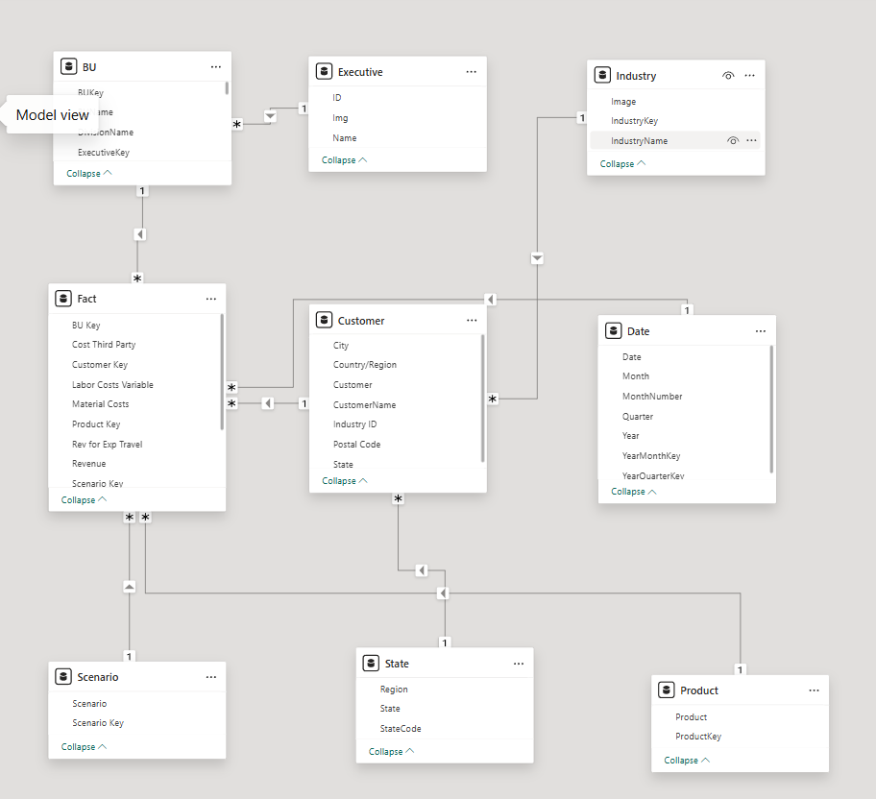

Slide 7
Star Schema Design
A Star Schema was implemented where the fact table is connected to multiple dimension tables using one-to-many relationships.
Benefits:
Faster report performance
Easy filtering
Accurate aggregations
Better analytical queries
A dedicated Date table was created to enable time-intelligence calculations such as YTD and YoY growth.

Slide 8
Key Business Metrics
Revenue Total sales amount generated.
Cost of Goods Sold (COGS) Material Cost + Labor Cost + Taxes + Travel Expenses + Third-Party Cost
Gross Margin Gross Margin = Revenue − COGS
Gross Margin Percentage (GM%) GM% = Gross Margin ÷ Revenue
Revenue Variance Revenue Variance = Actual Revenue − Budget Revenue
Gross Margin and GM% are used to evaluate business profitability.

Slide 9
Customer Profitability Dashboard
This dashboard provides:
Revenue vs Cost vs Profit comparison
Customer ranking by revenue and margin
Customer contribution percentage
Dynamic filtering by region, industry and scenario
The dashboard helps identify customers generating revenue but not profitability.

Slide 10
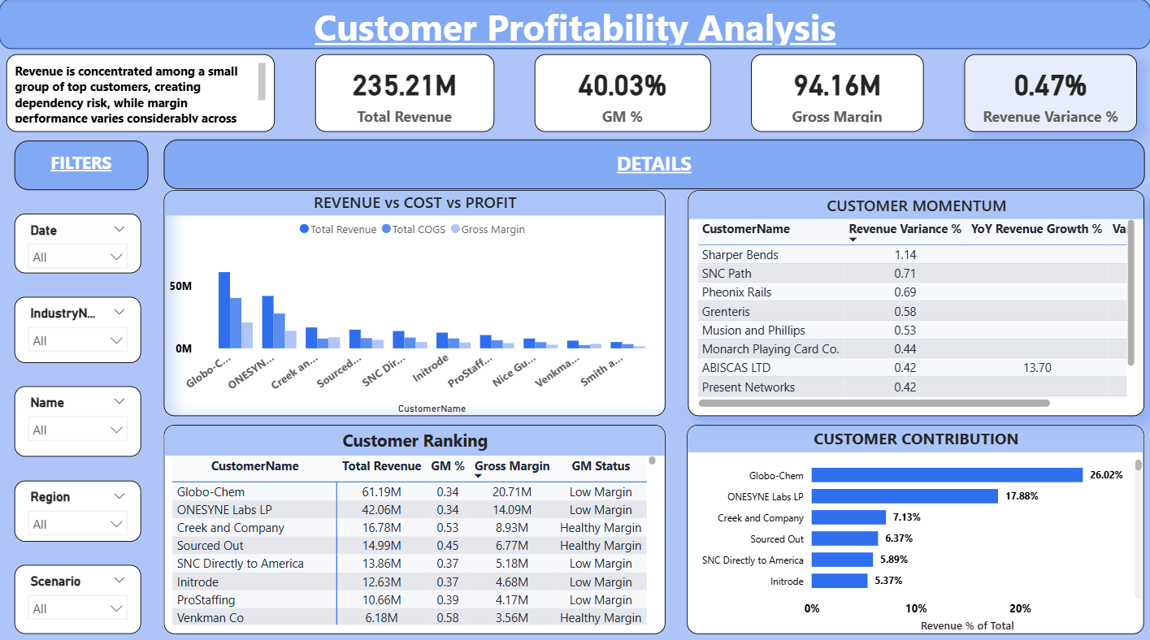

Slide 11
Executive Performance Analysis
This section analyzes performance against targets:
Actual vs Budget revenue
Revenue variance by executive
Business unit margin performance
It highlights underperforming and overperforming executives.

Slide 12
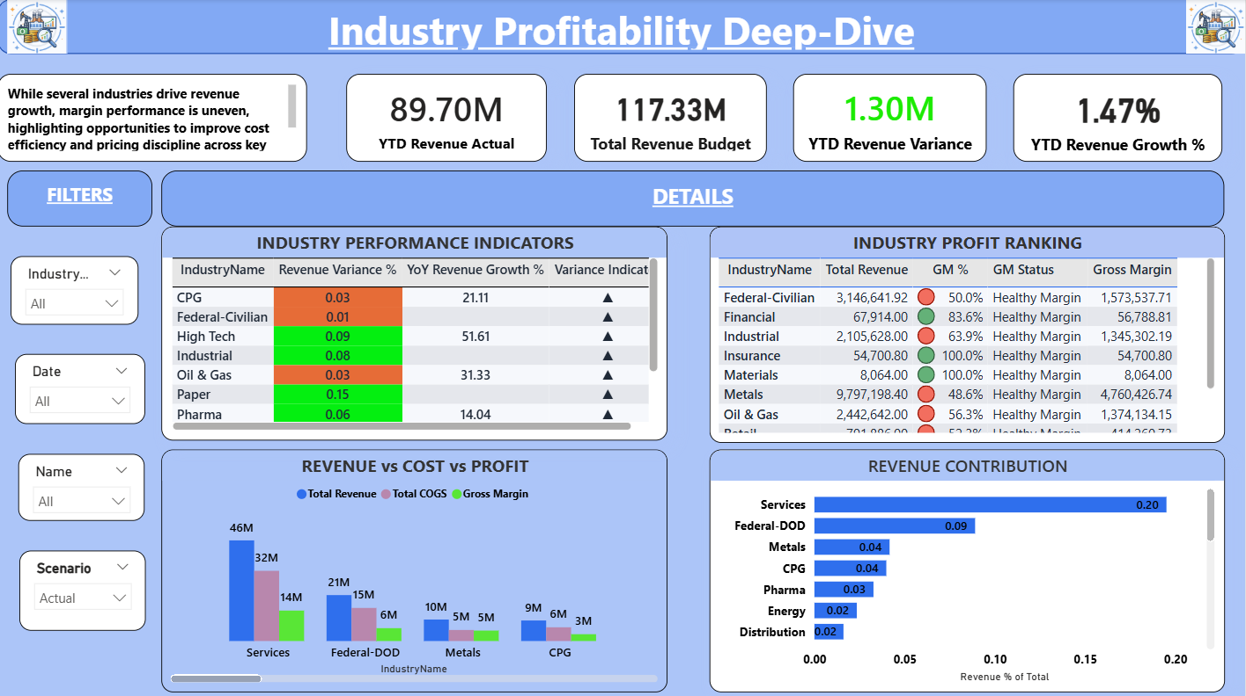

Slide 13
Industry Profitability Analysis
This analysis compares industries based on:
Revenue contribution
Profitability (GM%)
Growth trends
The dashboard helps identify industries that generate sales but low profit margins.

Slide 14
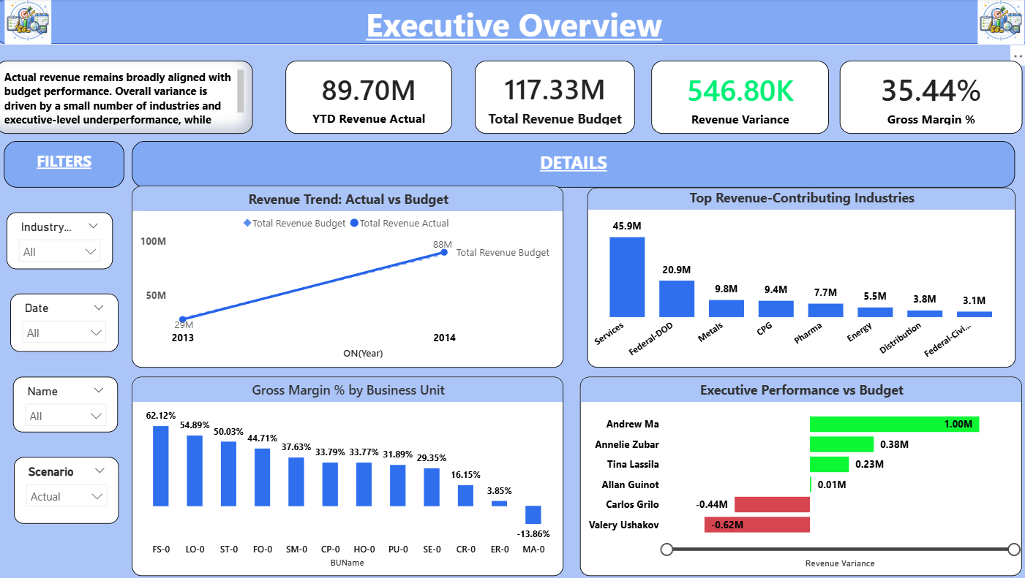

Slide 15
Time Series Analysis
Time intelligence calculations were implemented:
Year-to-Date (YTD): Measures performance from the beginning of the year to the selected date.
Year-over-Year (YoY): Compares performance with the same period in the previous year.
These metrics help track business growth trends and seasonal performance changes.

Slide 16
Key Insights
Revenue is concentrated among a small number of customers.
High revenue does not always result in high profitability.
Some industries show strong sales but lower margins.
Budget variance reveals underperforming executives.
Cost behavior significantly affects gross margin.

Slide 17
Benefits of the Dashboard
The dashboard enables management to:
Identify profitable customers
Monitor executive performance
Compare actual performance with targets
Detect cost inefficiencies
Make data-driven business decisions

Slide 18
Conclusion
The Customer Profitability Analysis dashboard provides a comprehensive view of business performance by combining financial metrics and interactive visualization.
The system allows organizations to focus not only on increasing revenue but also on improving profitability and operational efficiency.

Slide 19
Thank You

